Slide 1
BU Sustainability: Understanding How Weather Impacts Waste
Team 2
Zeqi Wang, Timur Zhunussove, Baicheng Fang, Akshad Ramnath

Slide 2



Project Motivation
The primary motivation for the project is to find a correlation between weather and waste generation at BU helping BU Sustainability to take care of our campus.

Slide 3

Goal of the project
The goal of this project is to see how BU sustainability can potentially improve waste storage location in the case of adverse weather conditions.

Slide 4
Background to understand the project
Understanding of python:
In particular matplotlib and the various plotting and chart features that are available to us to assist with data analysis and finding correlations.
A basic understanding of waste metrics:
The readings provided by the client obtained from third party vendors Contelligent and Casella measured PSI fullness of compactors
Other python tools to help with analysis:
Having a basic understanding of k means clustering and other features help find correlations while analysing the data.

Slide 5
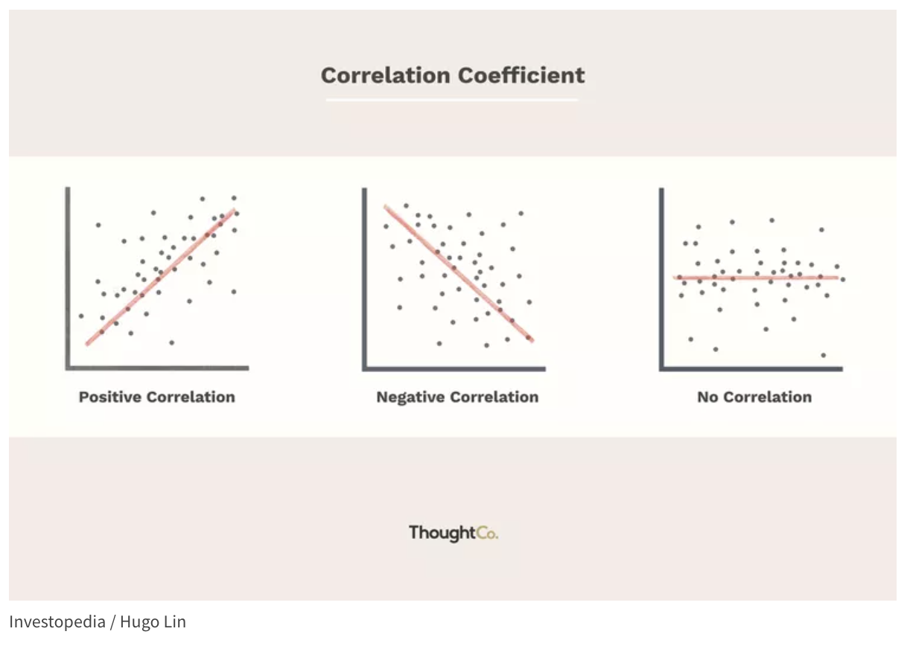
Background to understand the project - Correlation Coefficient
+1
-1
0
Notes:
Zeqi: Now before we go through our team’s research, there is a very simple concept for you to understand - The CC.
It is a statistical measure that describes the degree of relationship between two variables.(For example the psi value and temperature) and the coefficients are ranged from +1 to -1.
If the correlation coefficient is positive, it means that there is a direct relationship between the two variables - as one increases, so does the other. If it is negative, it means that there is an inverse relationship - as one increases, the other decreases.
(Are there any question? Pretty Straight Forward?)

Slide 6
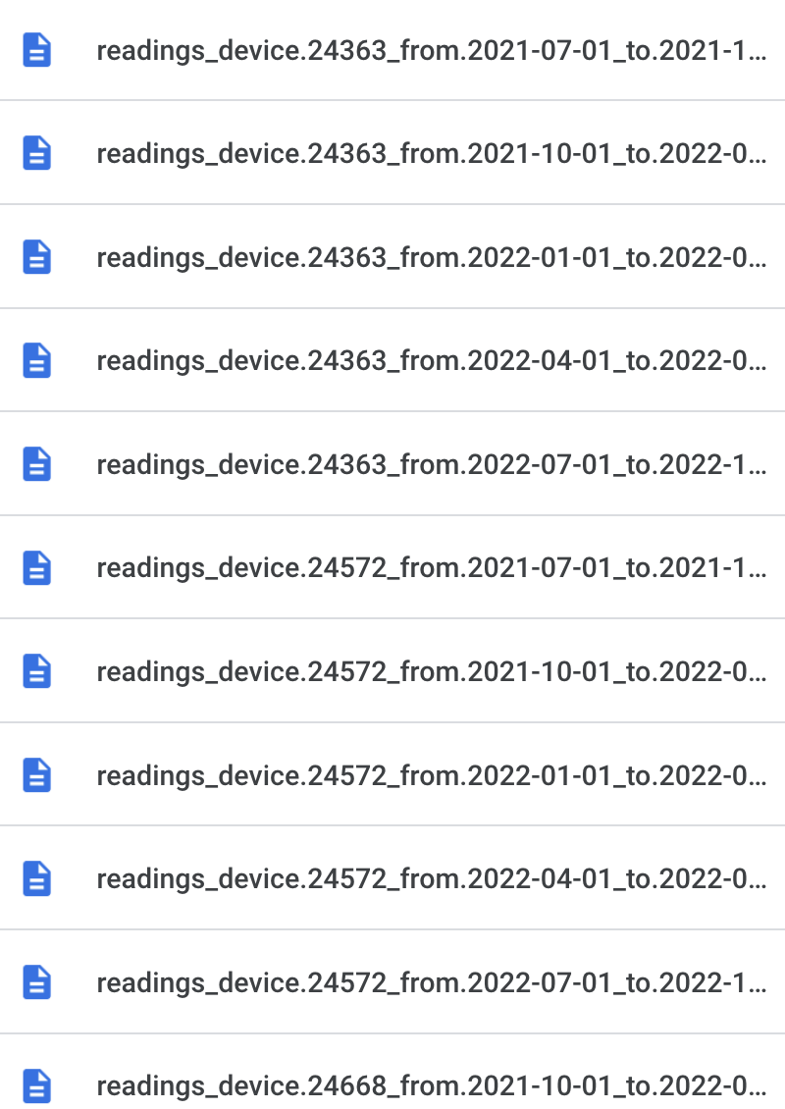
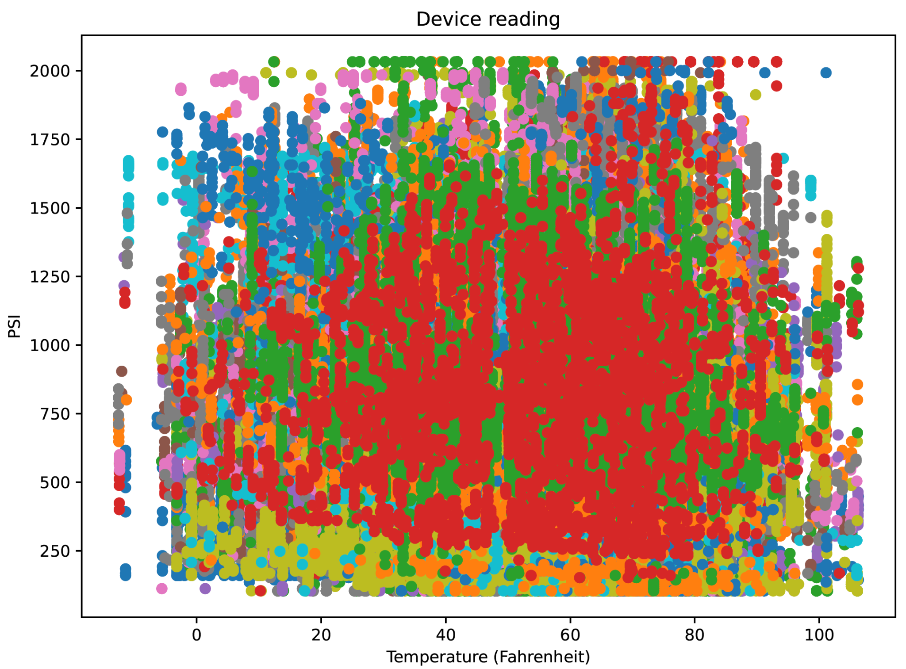
PSI reading devices analyzation (Early) - Zeqi Wang
(part of the data)
Notes:
The documents I was focusing on was those hundreds of ‘reading device’ files.
点：Unlike last time when I was overlapping all the devices together and find the CC (which is no conclusion), this time I will focus on each single devices.

Slide 7
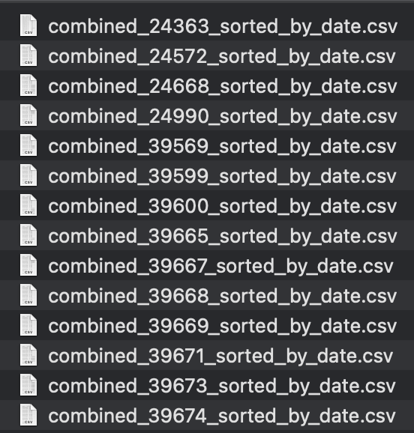
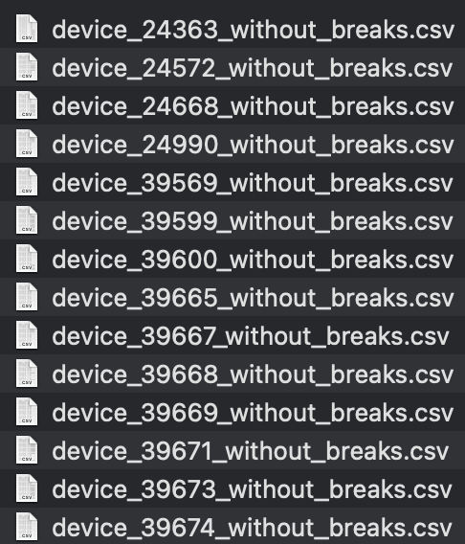
PSI reading devices analyzation (Early) - Zeqi Wang
VS
Original data with all dates
(part of the data)
Data without winter & summer breaks
(part of the data)
Notes:
点：Considering the factor of winter and summer breaks where school population may affect different results. I separated them into two packs of data set. One that includes all the date from the original data source, and the one that without winter and summer breaks. The dates of breaks are collected from our BU school calendar.

Slide 8
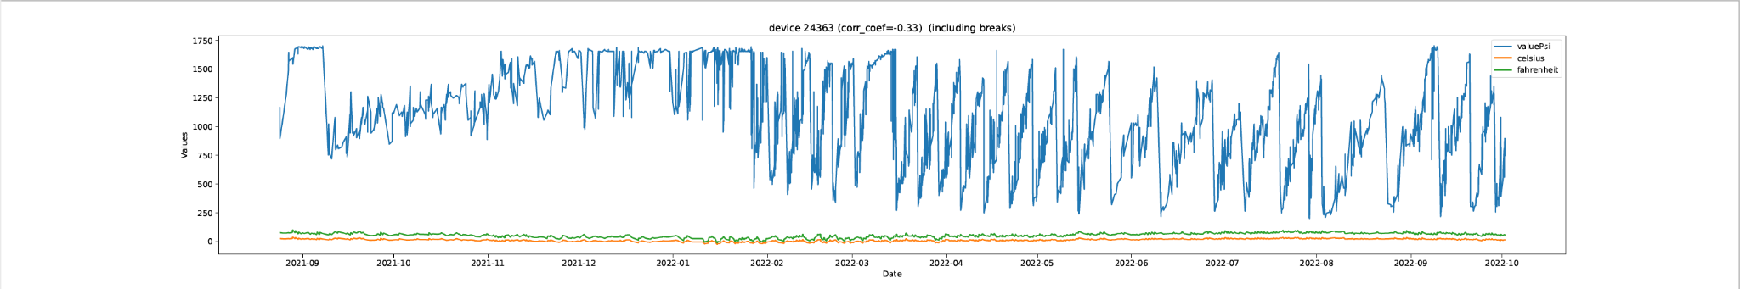
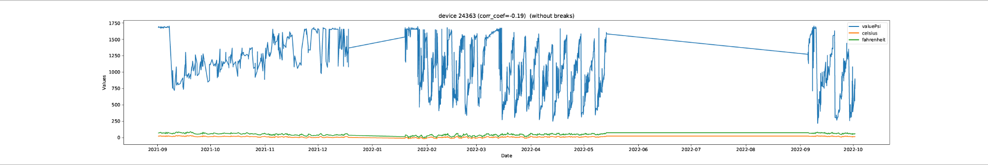
PSI reading devices analyzation (Early) - Zeqi Wang
With breaks
VS
Without breaks
Notes:
And here is an example of the comparison of device 24363 before and after deleting the breaks. The graph shows the process of the change of psi values and temperatures between 2021 and 2022. Don’t worry about those strokes that’s just the program need to make continuation while drawing the graph. There are no values in these days and we won’t take in those dates when doing the calculation.
So I was still using the strategy of calculating the correlation coefficients, but this time, I calculated every single one of the devices and plot them out. 点

Slide 9
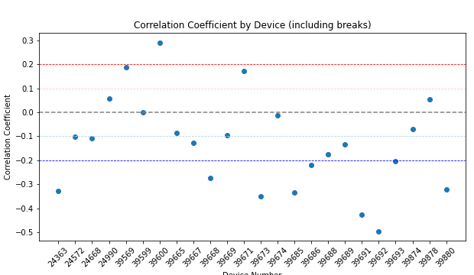
PSI reading devices analyzation (Early) - Zeqi Wang
Stronger positive relationship
Weaker positive relationship
Too weak to make reference
Weaker negative relationship
Stronger negative relationship
Device Number
(Assume the higher Psi Value, the more waste collected from the device)
Notes:
Here is the coefficient graph for devices that include all the dates. The horizontal axis represents all 24 devices by their device number, and the vertical axis represents the relationship between temperature and psi values. (And yes, we assume the higher psi value, the more wastes it was collected at the device).
Now we have some devices that shows a bit more significant relationships. Although most of them are just around .3 or .4, still kind of weak, but at least we can make some references from them.
Here I have made some thresholds to separate the level of relationship. The warm color represents positive relationship. And the cold color represents negative relationship. You can remember in this way, this part means the warmer the temperature, the more wastes the device generates. And here, the colder the temperature, the more wastes the device generates.
And for better reference, I set weak and strong thresholds for them. Simply shown in the graph, Those beyond ± 0.1 is weaker relationship, and these beyond ± 0.2 is stronger relationship. They can also be distinguished by lighter and darker colors. And those devices within ±0.1 will not be considered since we can’t make conclusion for them.

Slide 10
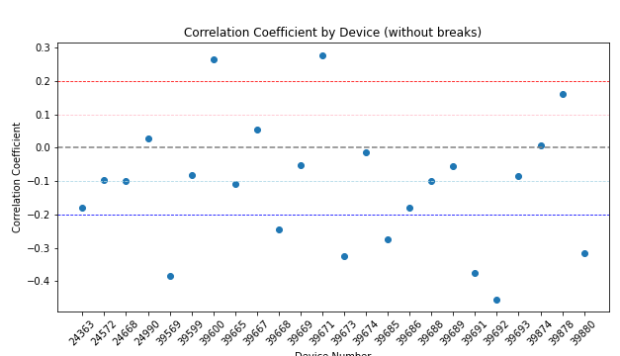
PSI reading devices analyzation (Early) - Zeqi Wang
Stronger positive relationship
Weaker positive relationship
Too weak to make reference
Weaker negative relationship
Stronger negative relationship
Device Number
(Assume the higher Psi Value, the more waste collected from the device)
Notes:
And here is the graph when not considering the winter and summer breaks. Same concept as before.
慢慢地点来点去: and when I switch between these two graph, you can see there are some devices have significant changes with the factor of breaks, which is quite interesting.

Slide 11
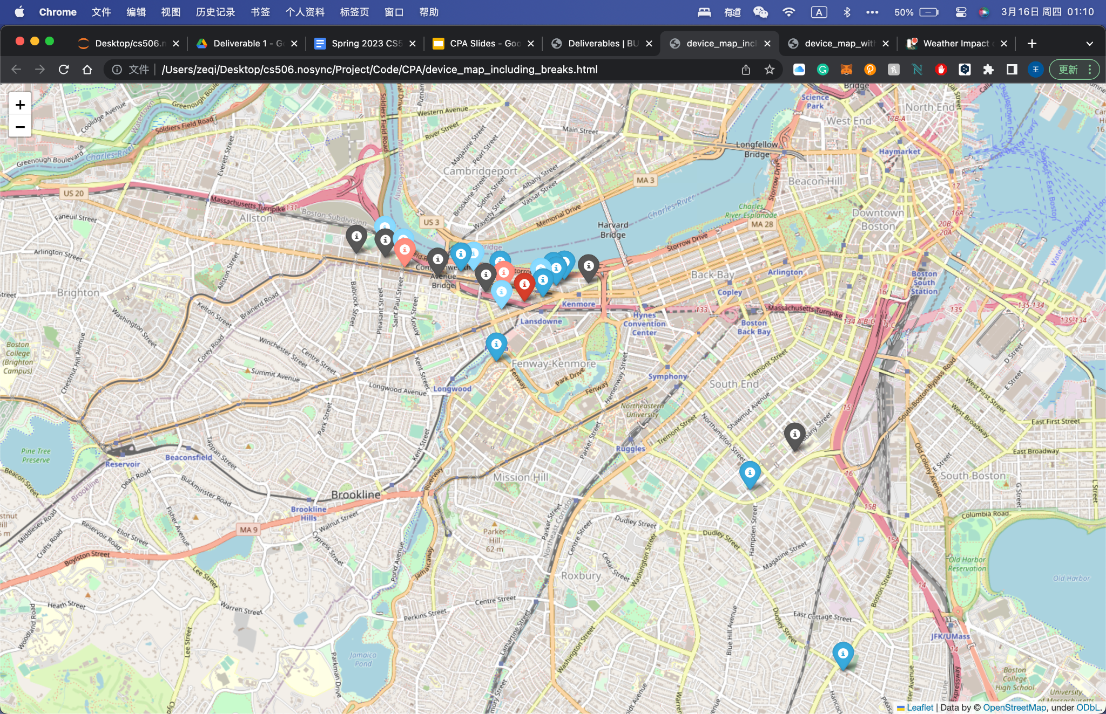
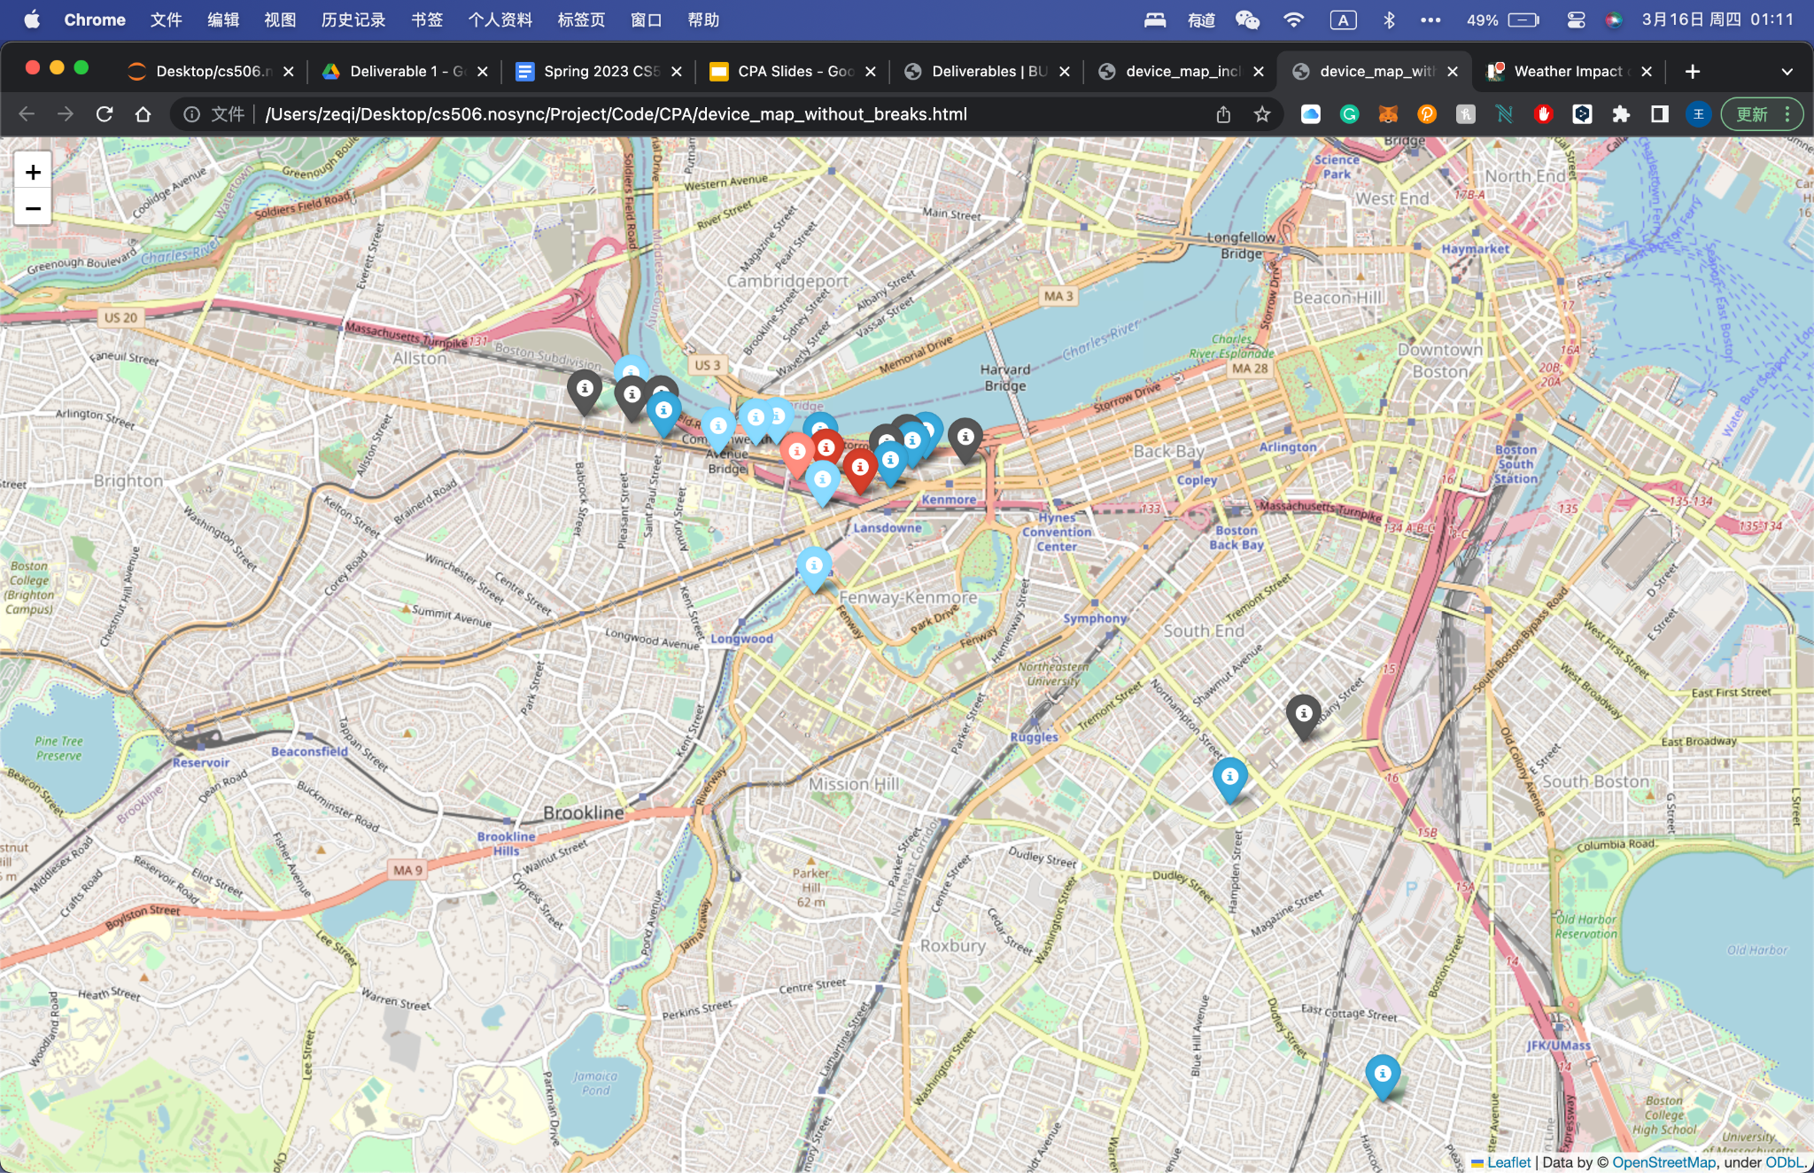
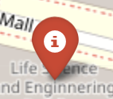



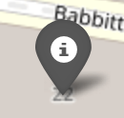
PSI reading devices analyzation (Early) - Zeqi Wang
Relationship Map (including breaks)
Relationship Map (without breaks)
(click for more details)
(click for more details)
Strong Positive
Weak Positive
Strong
Negative
Weak
Negative
Almost
No
Relation
Notes:
And to make it more visualizable, I plotted each device on the map, and for reminder, the pin colors represent different level of the relationship, you can make it as a reference when looking at the map.
Once you have that in mind, we can start to take a look at these maps. If you click the picture, you will be directed to the website of the map.
And for convenience, the tab title indicates the purpose of the map. Also, if you click on the pins, you will be able to see it’s location information, and the correlation coefficient.
Take an example of Warren Tower, when students are out of the campus, we are able to make a stronger reference between the psi and temperature.
But for research building like Life Science, it seems very stable where it always indicating a strong positive relationship.
So we haven’t go deep down into analysis of each single building yet since the current map is just for a reference. After we finished the slide we realized there are some issue of the data and we need to preprocess a bit more to make it accurate. (I will talk about it at the end of the slide)

Slide 12
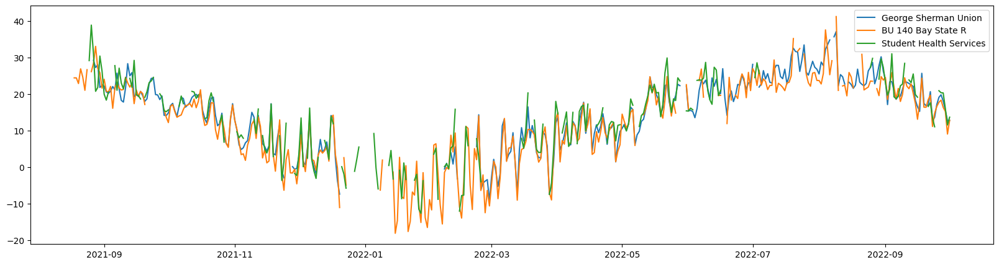
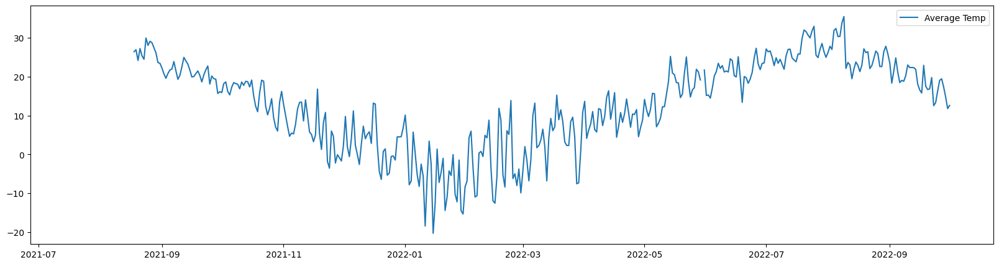
Assumptions and limitations
Temperature from different devices are close within slight margin
Averaged daily temperature

Slide 13
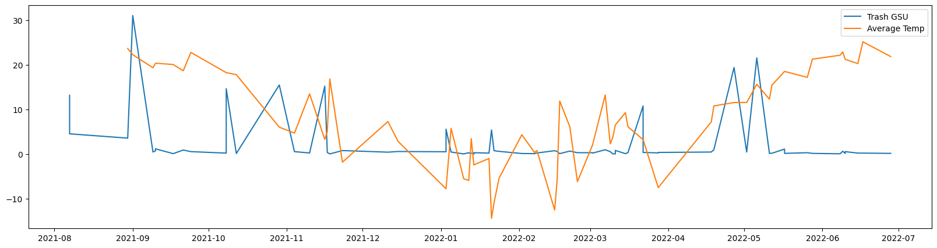
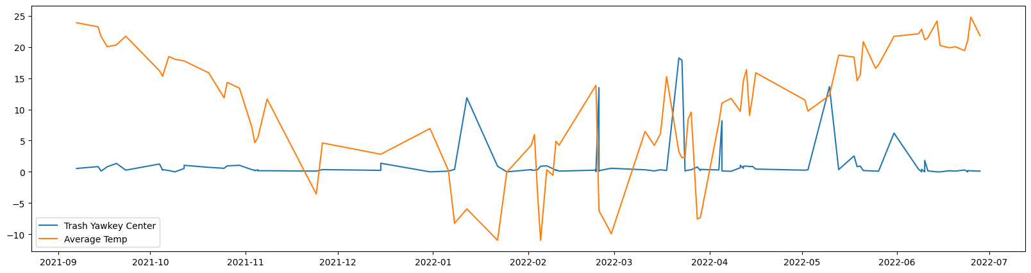
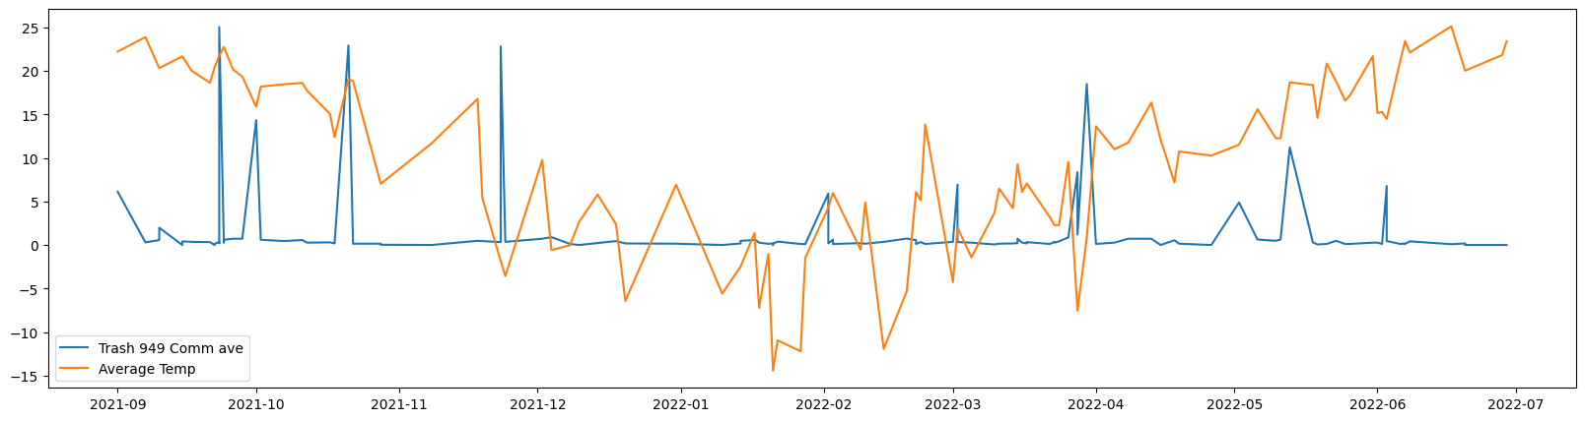
Preliminary analysis of most grossing locations
Correlation coefficient: 0.11893668357161091
According to our findings there is very weak correlation between the average daily weather and the weight of produced trash
Correlation coefficient: -0.17200522527145373
Correlation coefficient: 0.03485458343604092

Slide 14
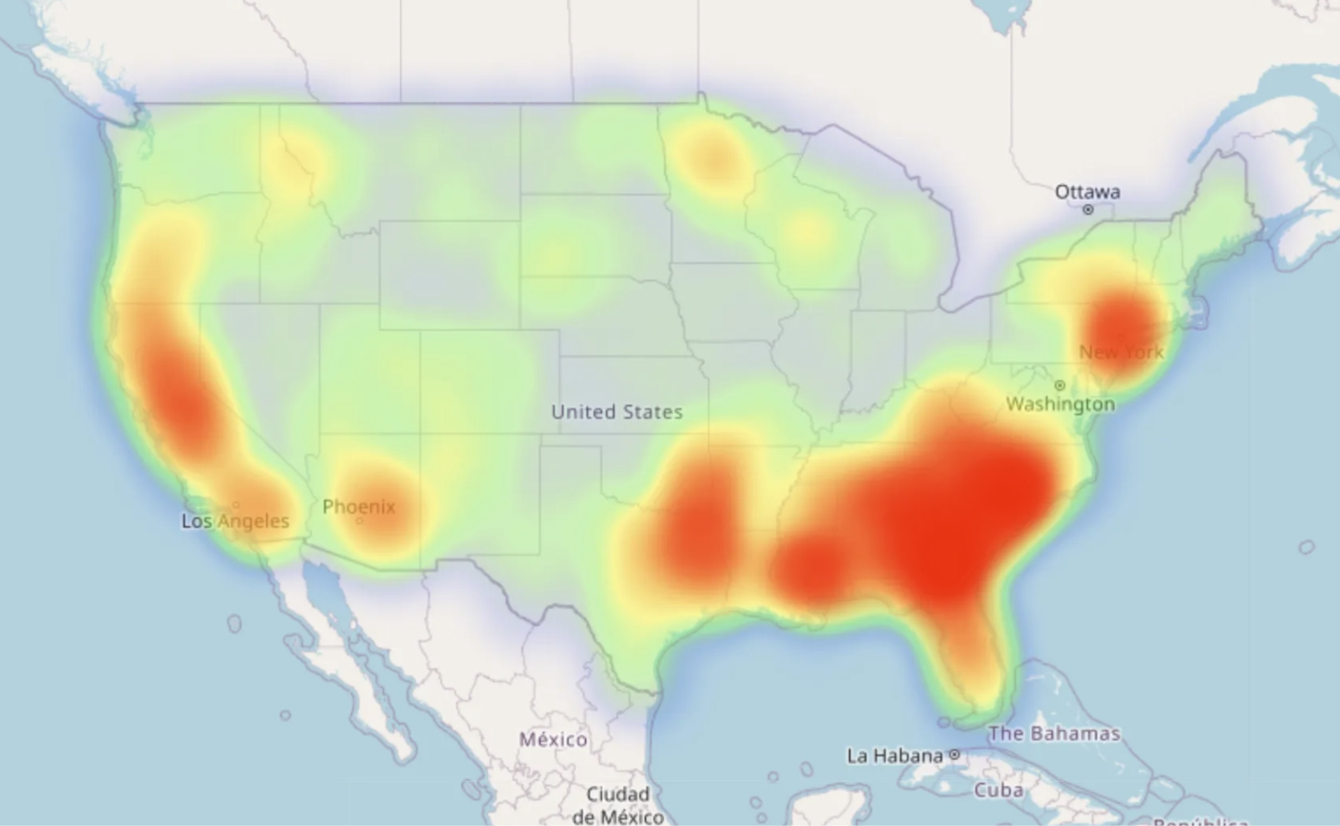
HeatMap Analyzation - Baicheng Fang
The major benefit of heatmap visualization is that it enables data to be presented visually which allows us to easily consume information and make more sense of it.
Color of the graph can quickly give a sense of the density. Where the darker the red, the greater the density.

Slide 15
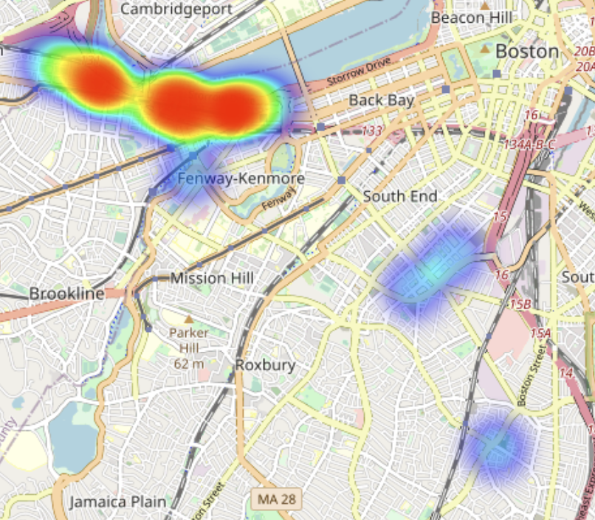
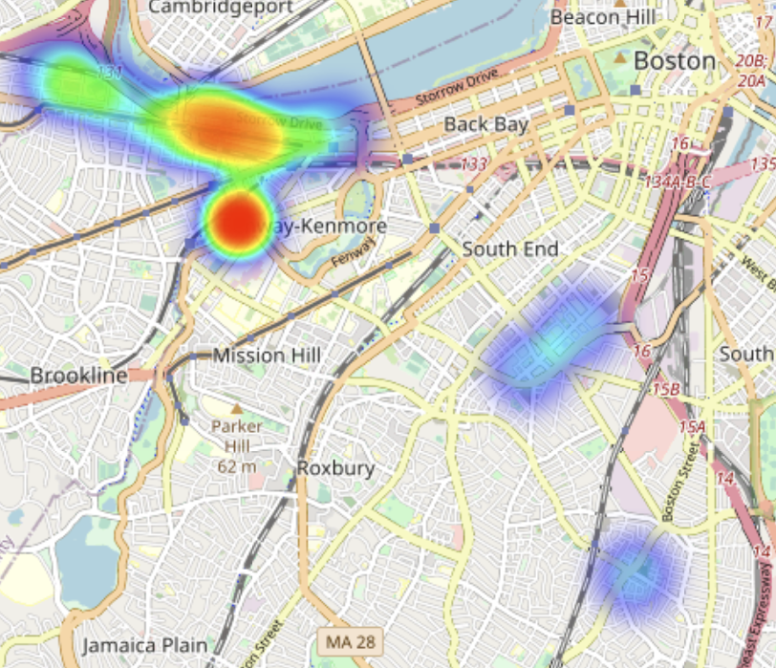
HeatMap Analyzation - Baicheng Fang
HeatMap of Trash
HeatMap of Recycling
Notes:
We can directly tell that in both cases, medical campus produce little waste.

Slide 16
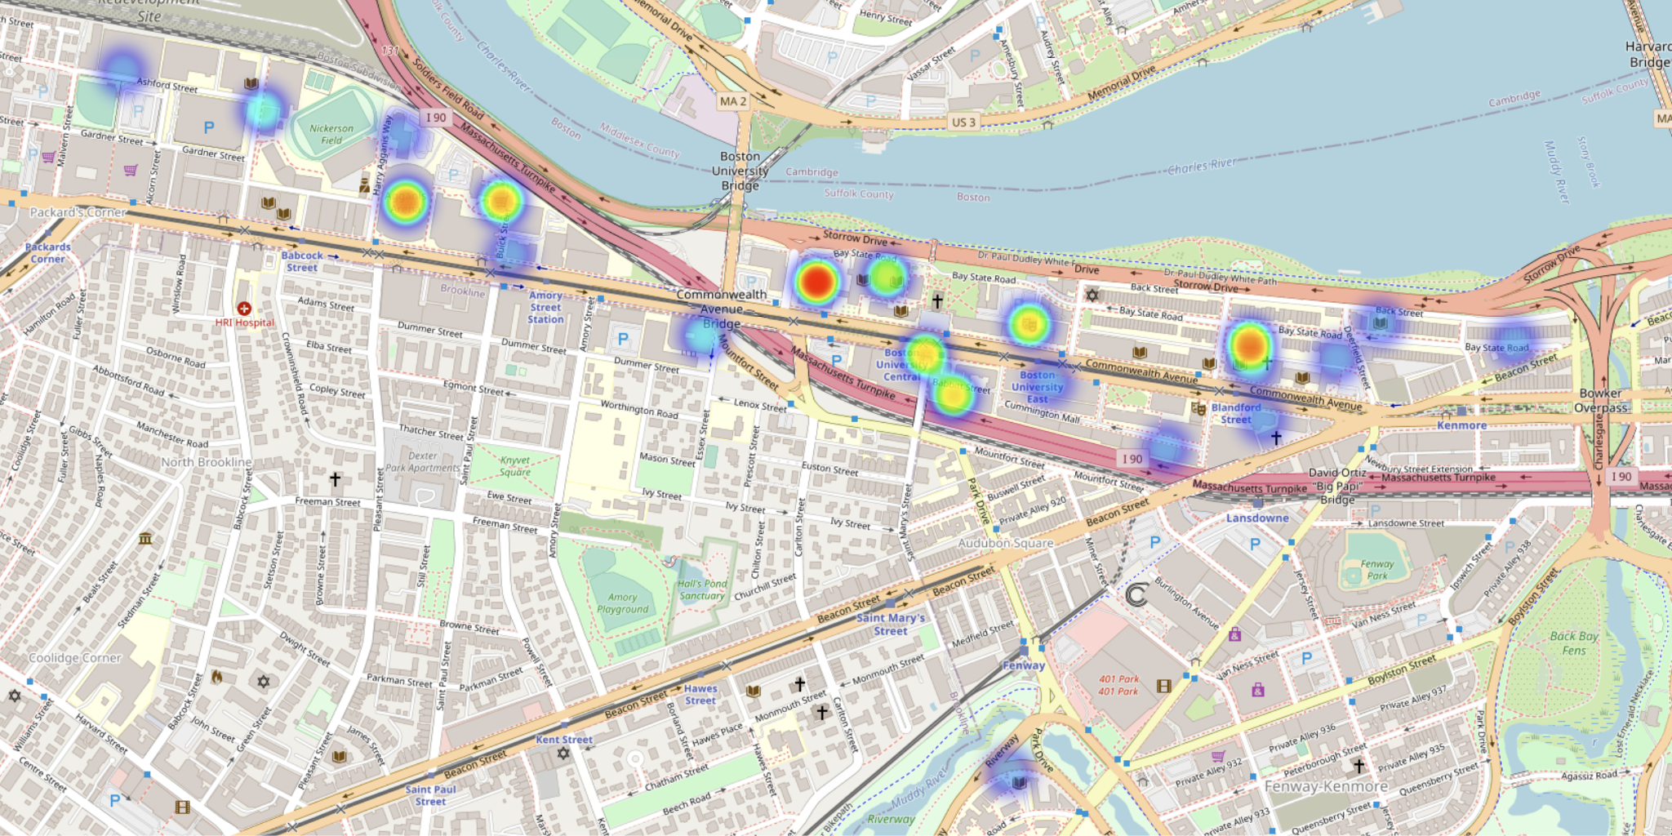
HeatMap Analyzation - Baicheng Fang
Trash on Charles River Campus
From heatmap visualization we can intuitively tell that some sites are the main waste producer like GSU, Towers and Agganis Arena.

Slide 17
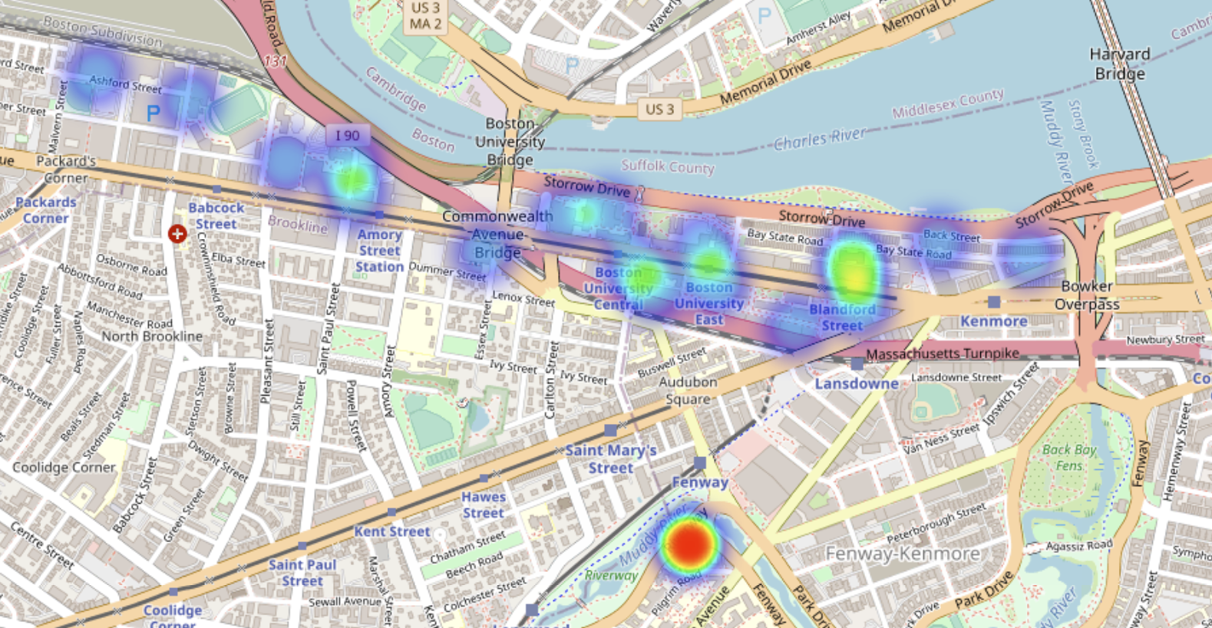
HeatMap Analyzation - Baicheng Fang
Recycling on Charles River Campus
Unlike the situation of trash, it is interesting that Fenway campus is way better at generating recycling.

Slide 18
Early Conclusion
By looking at single location, we are able to make reference about the relationship between waste generation (Psi) and temperature. (Threshold CC at least ±0.1)
Client can freely include or exclude the factor of school breaks when making decisions.
The heatmap can tell us what locations generate more wastes (Ton).
Limited to short time frame and weight (ton vs psi)
Notes:
Here we can make some simple conclusion, it’s an early version for references since we need more work on it.
点 First, when we looking at the single location of each device, we can make some decent reference for more than half of the locations, given that if we set the threshold of Correlation Coefficient to at least +- 0.1.
点 And depending on client’s needs, we can simply provide the result based on with or without breaks, as some locations seems to have different results due to the factor of holidays.
点 More importantly, using the tonnage instead of psi values, we might have different results just like the research from Timur and Baicheng. I personally would also prefer using weight as the factor of waste generation instead of psi maybe just because weight is making more sense. But also, the data we have from weight is just a short time frame compared with psi values. So the conclusion from tonnage vs temperature could be limited.

Slide 19
Future
Finding the pattern of waste generation from more aspects.
weight of the waste instead of psi values?
getting more Device_Compaction frequency files?
Consider the waste generation at BU as a whole (e.g. wastes generated by all device on single day)
Starting to use some model to learn from the data and predict future data
Making a more precise correlation coefficient calculation by looking at every single day of each device.
Notes:
Here are some of the future steps we are going to take:
First, we might want to look at the waste generation from different aspects, for example, instead of looking at psi values, can we take more other features like the weight of the waste in the device. Also we can combine the situation of device compaction frequency and psi values, and see if we can make the psi analysis more accurate.
Second, we can take a look if we can see some patterns by looking at the waste generation as a whole, but not like the previous one where just simply overlap them. This time, we might want to sum up the total amount of waste generated each day at BU and to see if there is a strong relationship.
Third, we can start to use some ML model to learn from the data and make some predictions.
And for this one, which I mention before when I was demonstrating the relationship map, there needed to be some more precise calculation for the data. Let me show it by a graph. 点

Slide 20
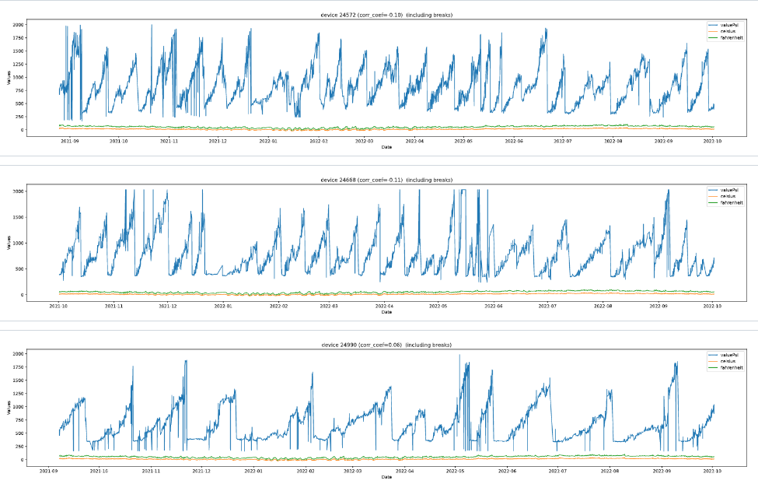
Future
Wanted to know why Psi value is having like a wave-like pattern.
Question: Is it being picked up at a fixed amount of time? Weekly or Monthly?
Notes:
Here, we have grab different devices’ graph for psi value vs. temperature. It’s interesting that we have found out most of the devices showing the psi value at a wave-like pattern. We didn’t think about it too much and we just simply plot them to the map. However, as we go deeper, we start to realize that it might due to the frequency of the trash being picked up, like bi-weekly or so.
Therefore, It’s inaccurate by just calculating the accumulative values, we need to single out each day’s actual waste generation and do it again, and we are still working on it.
Also, if we can gather more data from the tonnage or the weight of the trash being generated would help us provide the best result since the psi value is very unstable, and could be affected by many factors such as the material of the waste (metal vs plastic) and the state of the waste (solid vs liquid).
Other than that, this is what team 2 have right now. Thanks for watching 点

Slide 21
Thanks

